Slide 1
Deep Learning for The Neuro-diversed
Adhocmaster

Slide 2
RNN - TextGen
y^{<t>} (4,)
a^{<t>} (3,)
tanh
soft
max
+
w_{ya}(4, 3)
w_{ax} (4, 3)
w_{aa}(3, 3)
+
b_{y} (3,)
a^{<t-1>} (3,)
x^{<t>} (4,)
a^{<t>} = tanh(W_{ax}x^{<t>} + W_{aa}a^{<t-1>} + b_{a})
y^{<t>} = softmax(W_{ya}a^{<t>} + b_{y})
b_{a} (3,)

Slide 3
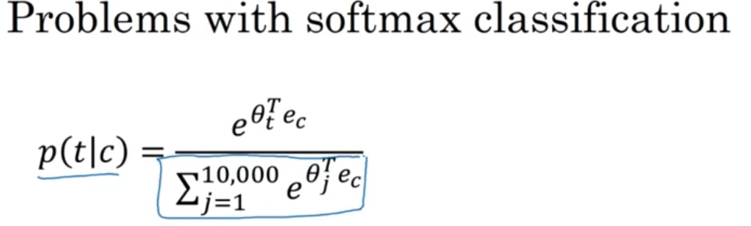
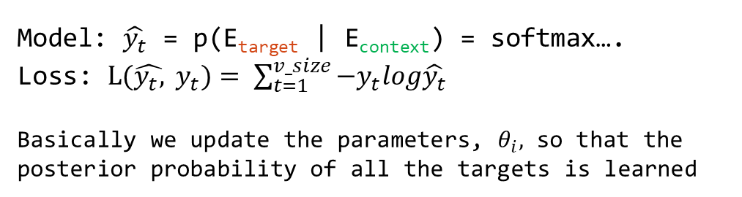
Word2Vec – Skip-Gram Model
I love to play cricket.
context target
Model: $\hat{y_{t}}$ = p(E_{target} | E_{context}) = softmax….
Loss: $L(\hat{y_{t},} y_{t})= \sum_{t=1}^{v_size}{−y_{t}log\hat{y_{t}}}$
Basically we update the parameters, $θ_{i},$ so that the posterior probability of all the targets is learned

Slide 4
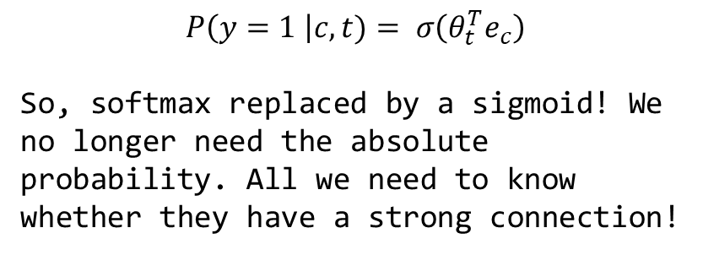
Word2Vec – Negative Sample
X
Y
$$P\left(y=1 \right|c, t)= σ\left(θ_{t}^{T}e_{c}\right)$$
So, softmax replaced by a sigmoid! We no longer need the absolute probability. All we need to know whether they have a strong connection!
Context word target
orange juice 1
orange king 0
orange of 0
orange the 0
Target is 1 if the distance between context and word is less than a threshold
0
1
0
0
King
juice
…
…
Context
Supervised Learning problem from unlabeled data!
We have 10k output nodes, but we only update weights based on a few negative weights

Slide 5
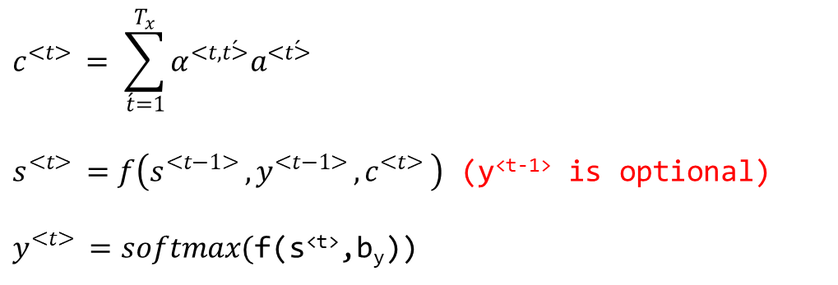

RNN Attention
Attention is a scalar value for an input embedding.
$$c^{<t> }= \sum_{\acute{t}=1}^{T_{x}}{α^{<t,\acute{t>}}a^{<\acute{t>}}}$$
$s^{<t> }=f\left(s^{<t−1> },y^{<t−1> },c^{<t> }\right)$ (y^{<t-1>} is optional)
$y^{<t> }=softmax($f(s^{<t>},b_{y}))
$$a^{\acute{t}}={[a}_{forward}^{<\acute{t>}},a_{backward}^{<\acute{t>}}]$$
$e^{<t,\acute{t>}}=FFN(s^{<t−1>}, a^{\acute{t}}$)
$$α^{<t,\acute{t>}}= \frac{exp⁡(e^{<t,\acute{t>}})}{\sum_{\acute{t}=1}^{T_{x}}{exp⁡(e^{<t,\acute{t>}})}}$$

Slide 6
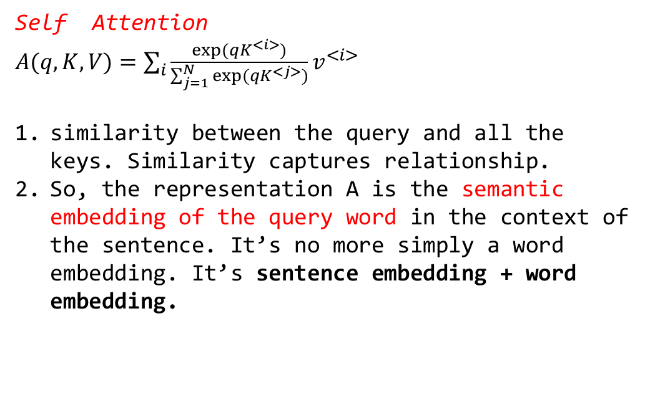
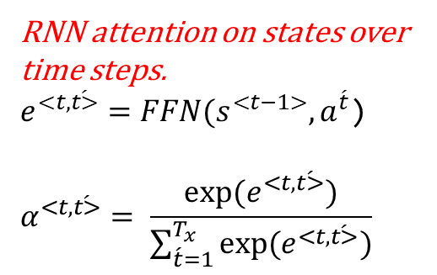
Transformer attention
RNN attention on states over time steps.
$e^{<t,\acute{t>}}=FFN(s^{<t−1>}, a^{\acute{t}}$)
$$α^{<t,\acute{t>}}= \frac{exp⁡(e^{<t,\acute{t>}})}{\sum_{\acute{t}=1}^{T_{x}}{exp⁡(e^{<t,\acute{t>}})}}$$
Self Attention
$A(q, K, V)=\sum_{i}{\frac{exp⁡(qK^{<i>})}{\sum_{j=1}^{N}{exp⁡(qK^{<j>})}}v^{<i>}}$
similarity between the query and all the keys. Similarity captures relationship.
So, the representation A is the semantic embedding of the query word in the context of the sentence. It’s no more simply a word embedding. It’s sentence embedding + word embedding.

Slide 7
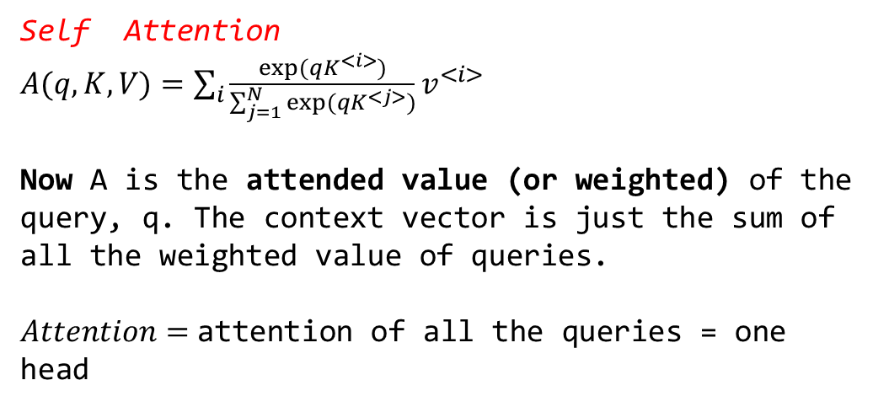
Transformer Attention
Self Attention
$A(q, K, V)=\sum_{i}{\frac{exp⁡(qK^{<i>})}{\sum_{j=1}^{N}{exp⁡(qK^{<j>})}}v^{<i>}}$
Now A is the attended value (or weighted) of the query, q. The context vector is just the sum of all the weighted value of queries.
$Attention=$attention of all the queries = one head

Slide 8
Resnets

Slide 9
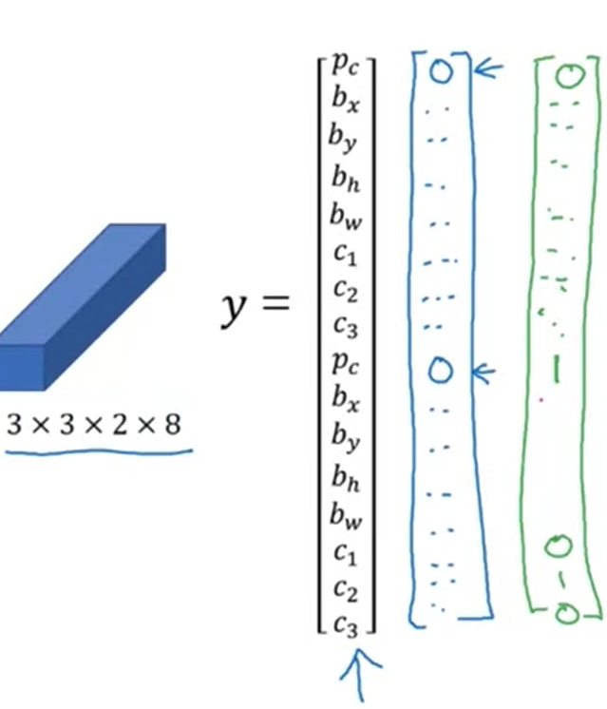
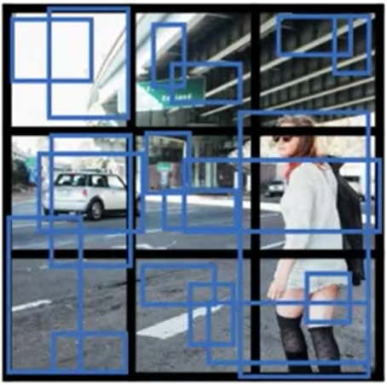
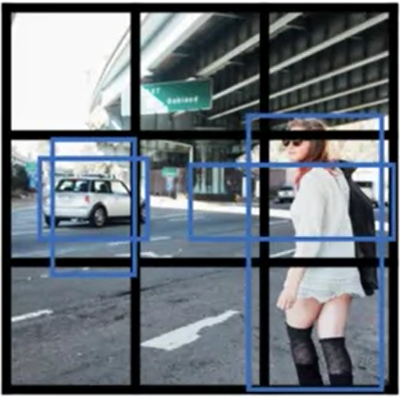
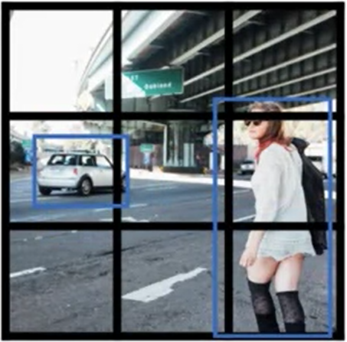
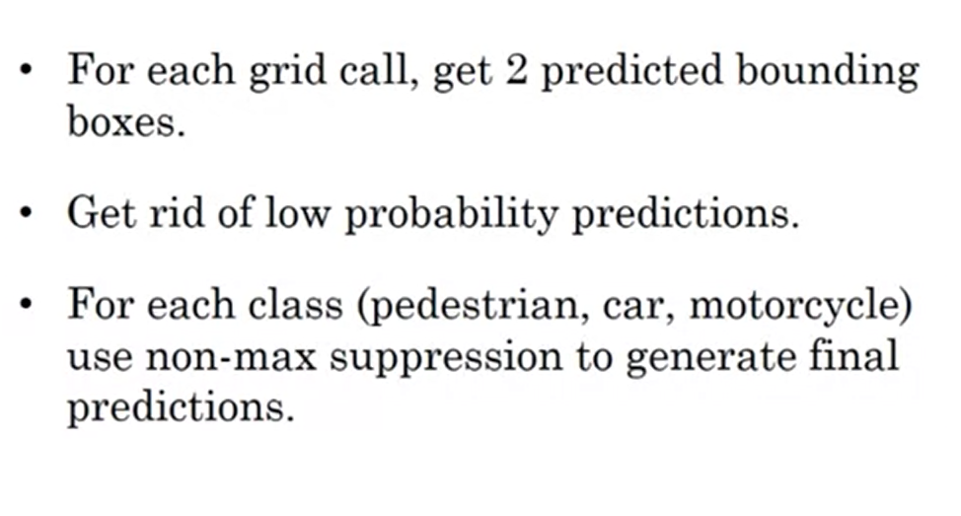
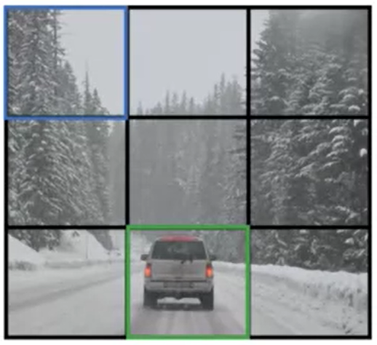
YOLO
Predictions for each grid cell
Non-max suppression for each cell and class (so, a cell can preserve objects of different classes
Backprop on preserved output

Slide 10
Unet

